Slide 1

Traveling Sales-man Problem
Algorithm’s Project Presented By:
Allaa Abdo
Doaa Mahmoud
Hagar Marzouk
Mai Tarek
Tasneem Omara

Slide 2


Table of Contents
About TSM
Preparation
1
2
4 Algorithms
Comparison
3
4
Traveling sales- man problem and solutions
Metrics and assumptions
Here you could describe the topic of the section
Compare the four algorithms

Slide 3
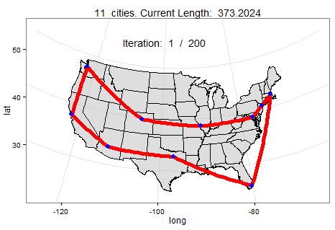
Introduction
What the optimum voyage path salesman should follow to visit every city exactly once and return to the starting city
Applications : Delivery company, vehicle routing, Drilling of printed circuit boards and job-shop scheduling.

Slide 4

Preparation
Complete Symmetric/ Undirected graph
City and Tour representation
Exact Solution
NP hard problem- O(N!)
can’t be solved by a polynomial time
Distance between two cities is the same in each opposite direction
Use Euclidean TSP
city is represented by a two-dimensional point

Slide 5
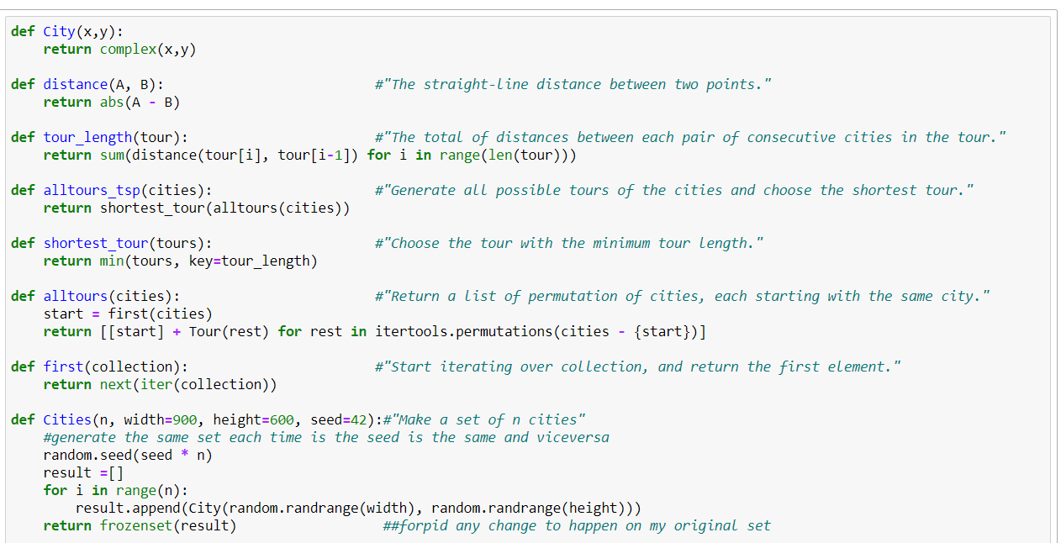
Implementation

Slide 6

Nearest Neighbor Algorithm
Make the tour go from a city to its nearest neighbor. Repeat.

Slide 7
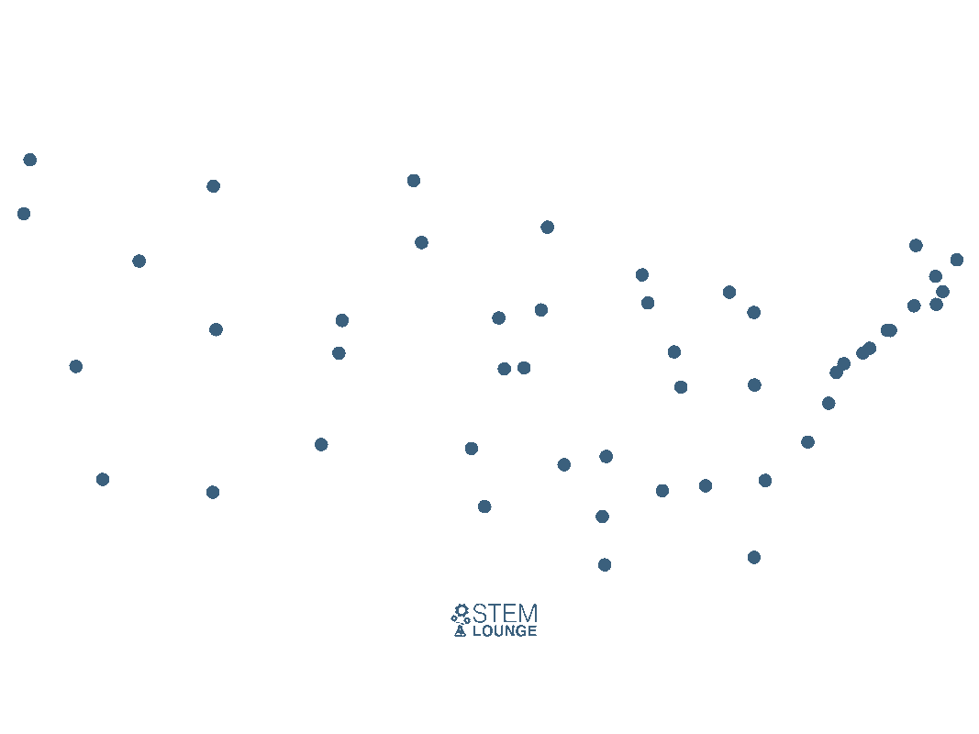
Nearest Neighbor
Make the tour go from a city to its nearest neighbor. Repeat.

Slide 8
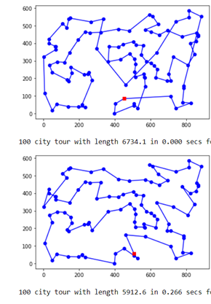
Nearest Neighbor (Cont’d)
Nearest
Neighbor
Repetition
Strategy

Slide 9
Nearest Neighbor (Cont’d)
Algorithm:
Find the unvisited city, C, that is nearest to the end city in the tour
Add C the end of the tour and remove it from the unvisited set
Stand on an arbitrary vertex as current vertex.
Find out the lightest edge connecting current vertex and an unvisited vertex V.
Set current vertex to V.
Mark V as visited.
If all the vertices in domain are visited, then terminate.
Go to step 2

Slide 10
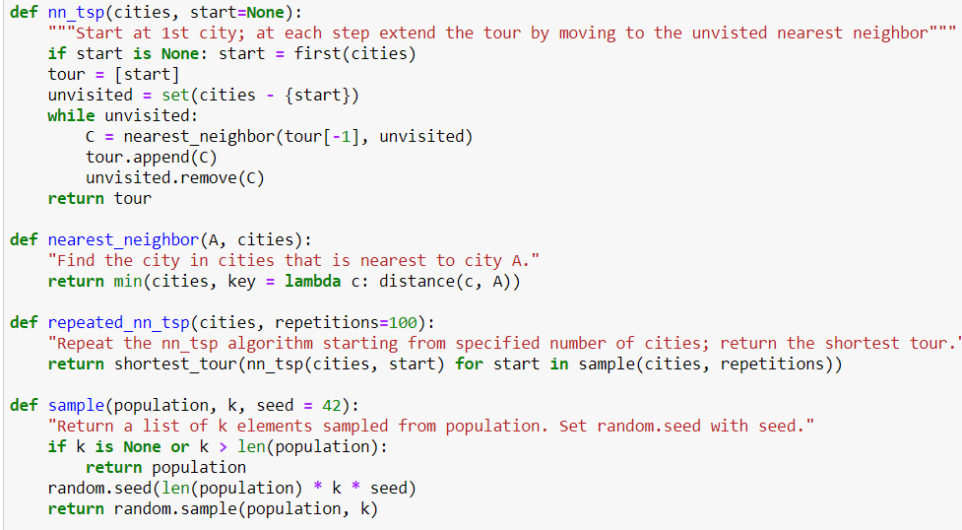
Nearest Neighbor (Cont’d)
Implementation:

Slide 11


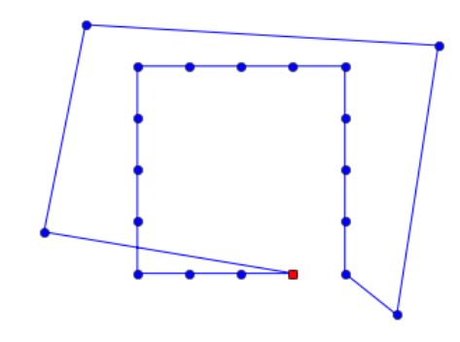
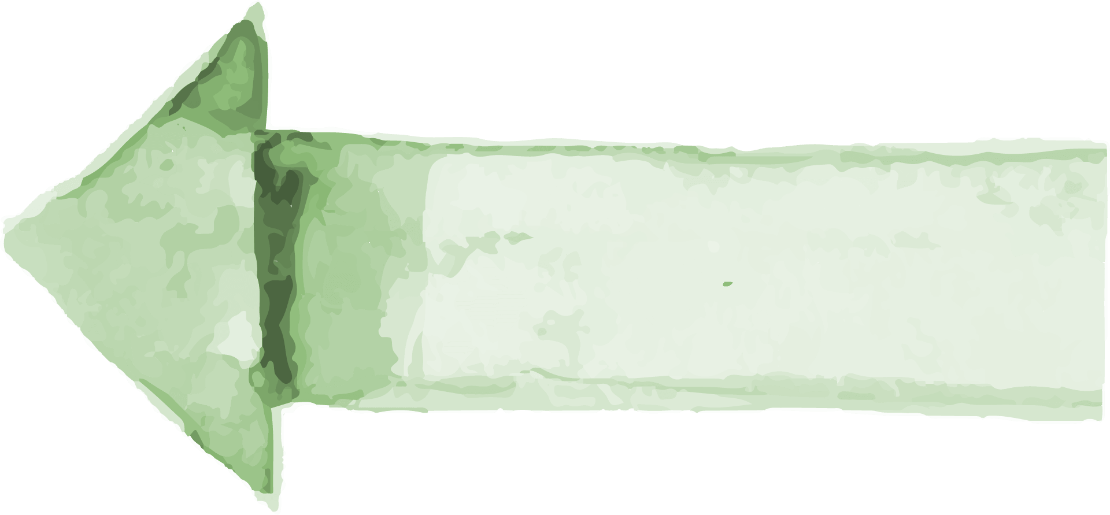
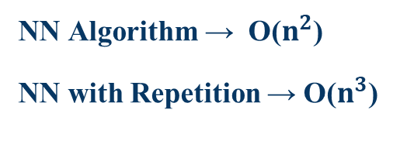
Nearest Neighbor (Cont’d)
Complexity
Summary
Cons
Saturn
NN Algorithm → O($n^{2}$)
NN with Repetition → O($n^{3}$)
It’s a gas giant and has several rings

Slide 12
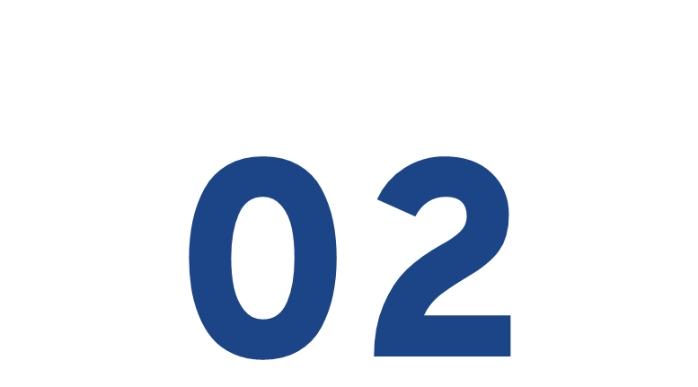
Greedy Algorithm
Find the shortest distance between any two cities and include that in the tour.

Slide 13
Greedy Algorithm
Greedy Algorithm
Maintain a set of segments; initially each city defines its own 1-city segment. Find the shortest possible edge that connects two endpoints of two different segments, and join those segments with that edge. Repeat until we form a segment that tours all the cities.

Slide 14
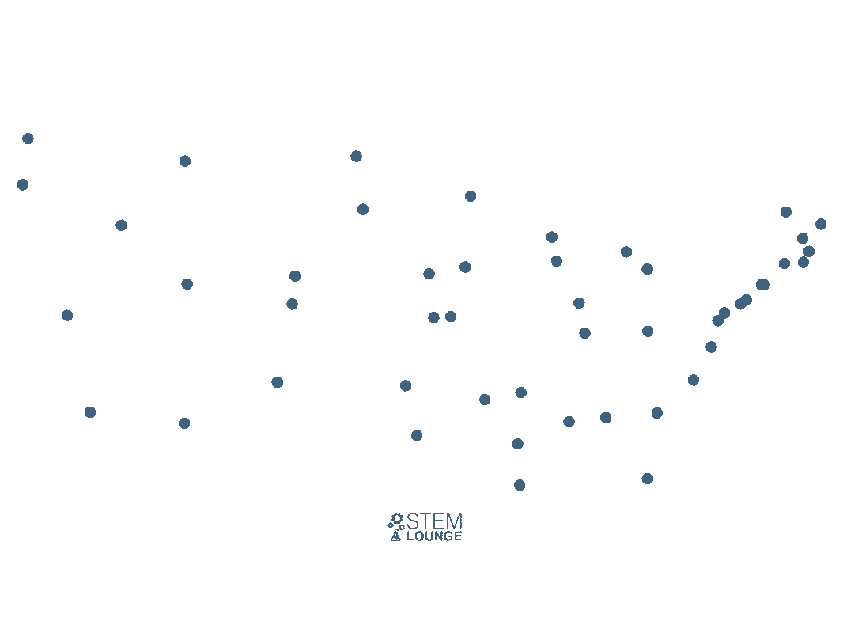
Greedy Algorithm (Cont’d)

Slide 15
Greedy Algorithm (Cont’d)
Algorithm:
Compute Shortest Edges: Pre-compute a list of edges, sorted by shortest edge first. The list contains one edge for every distinct pair of cities—if it contains (A, B) then it does not contain (B, A), and it never contains (A, A).
Join Endpoints: Maintain a dictionary that maps endpoints to segments, e.g. {A: [A, B, C, D], D: [A, B, C, D]}.
Create The Path: Go through the edges in shortest-first order. When you find an edge (A, B) such that both A and B are endpoints of different segments given a condition that no loops are formed. , then join the two segments together. Maintain the endpoints dict to reflect this new segment. Stop when you create a segment that contains all the cities.

Slide 16
Greedy Algorithm (Cont’d)
Algorithm:
A B C D
Shortest edge | Usage of edge | Resulting segment
BD = 2 | Join B to D | A,BD,C
AB = 4 | Join A to BD | ABD,C
CD = 5 | Join C to DB | ABDC
AD = 6 | Discard | ABDC
AC = 7 | Join DC to A | ABDCA
CB = 8 | Discard | ABDCA

Slide 17
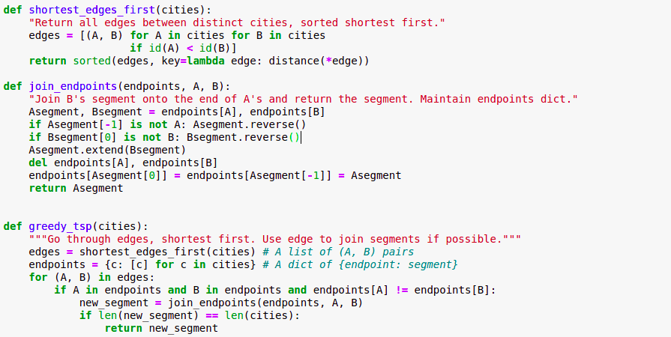
Greedy Algorithm (Cont’d)
Implementation:

Slide 18
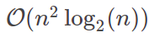
Greedy Algorithm (Cont’d)
Complexity:
Disadvantages:
It does not give the optimal solution.
The greedy algorithm is worse than nearest neighbors on the small map, but better on the big one.

Slide 19
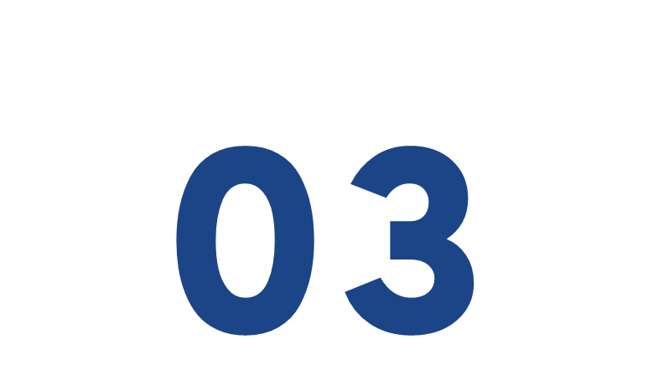
Divide and Conquer Strategy
Split the cities, join their optimal tours. Repeat.

Slide 20
Divide and Conquer Algorithm
Divide
Split the set of cities in half.
Conquer
Find a tour for each half
If we haven't yet reached the base case (3), we again divide both sets of cities
Combine
Join those two tours into one.

Slide 21
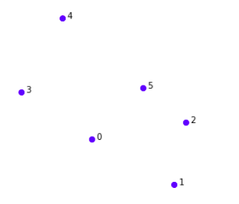
Divide and Conquer Algorithm (Cont’d)
Divide: Split the set of cities in half.

Slide 22
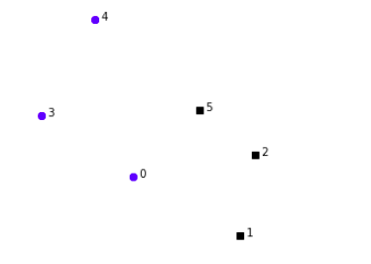
Divide and Conquer Algorithm (Cont’d)
Divide: Split the set of cities in half.

Slide 23
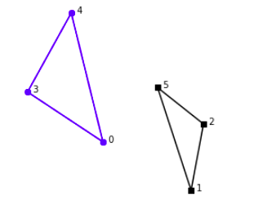
Divide and Conquer Algorithm (Cont’d)
Conquer: Find a tour for each half, if reached the base case
(3 cities in this example).

Slide 24
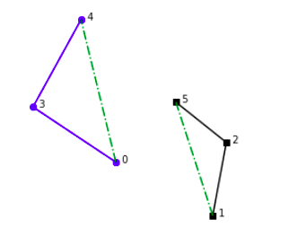
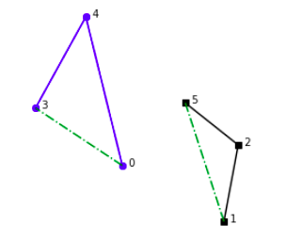
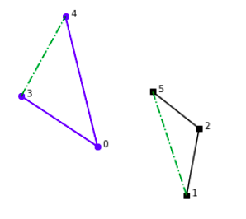
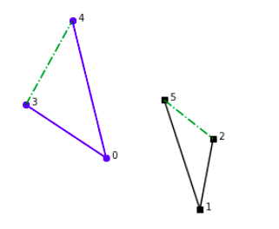
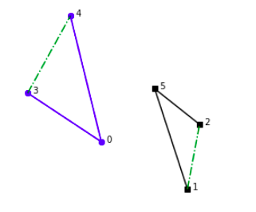
Divide and Conquer Algorithm (Cont’d)
Combine: Join those two tours into one.
Delete an edge from each tour

Slide 25
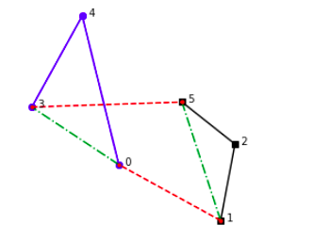
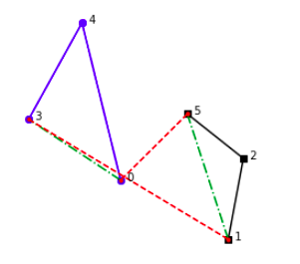
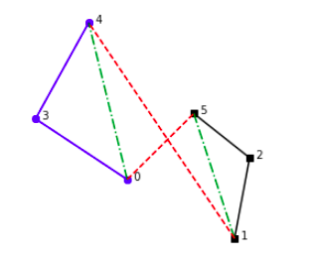
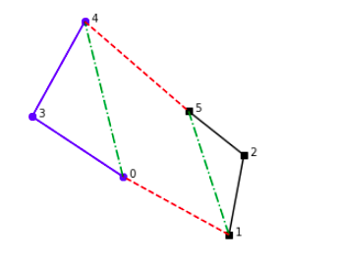
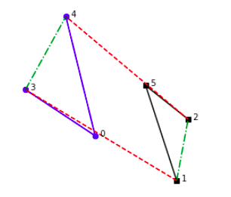
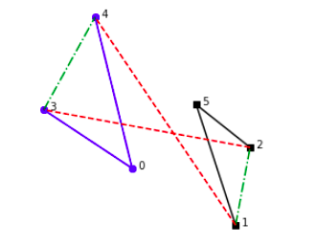
Divide and Conquer Algorithm (Cont’d)
Combine: Join those two tours into one.

Slide 26
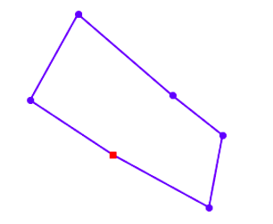
Divide and Conquer Algorithm (Cont’d)
Combine: Join those two tours into one.

Slide 27
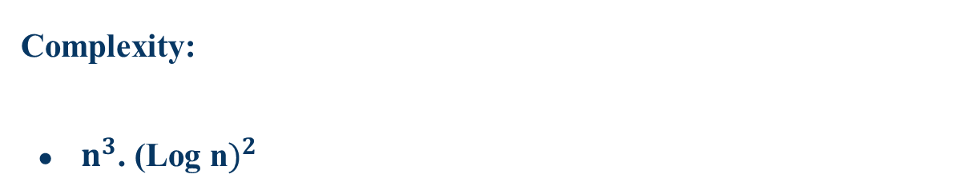
Divide and Conquer Algorithm (Cont’d)
Complexity:
$n^{3}$. ${\text{(}\text{Log} \text{n})}^{2}$

Slide 28
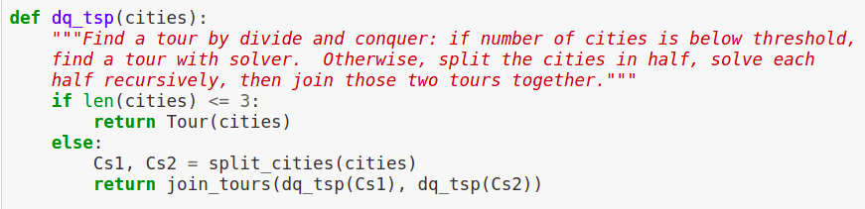
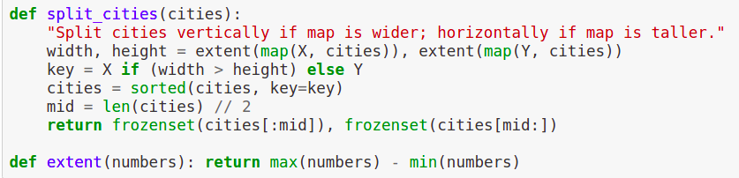
Divide and Conquer Algorithm (Cont’d)
Implementation

Slide 29
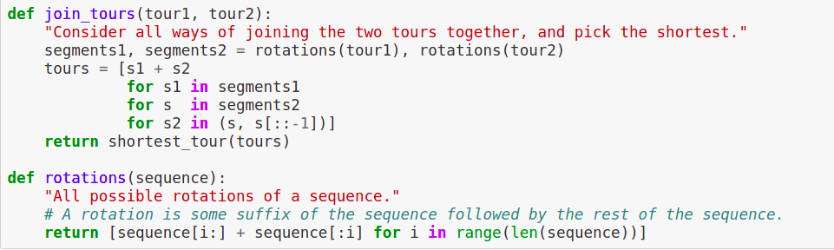
Divide and Conquer Algorithm (Cont’d)
Implementation

Slide 30
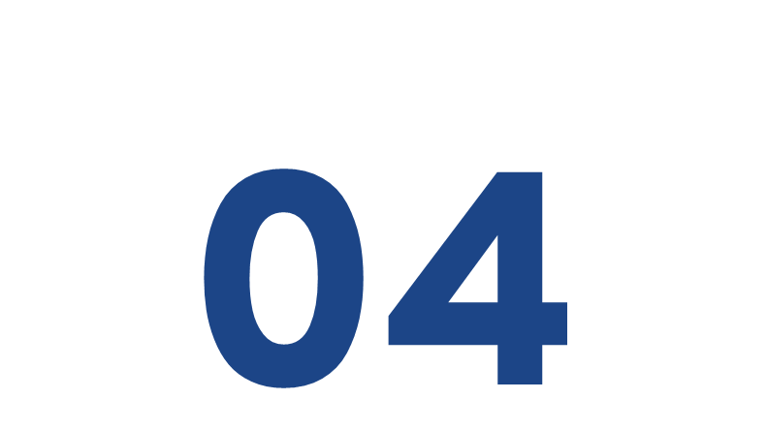
Minimum Spanning Tree Traversal Algorithm

Slide 31
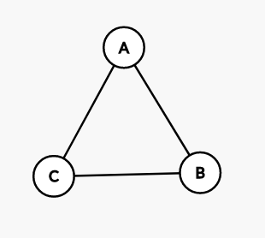
Minimum Spanning Tree Traversal Algorithm (2-approximate)
Minimum spanning tree is an approximate algorithm that works for the travelling salesman problem only if the problem satisfies Triangle-Inequality.
Triangle-Inequality: The least distant path to reach a vertex j from i is always to reach j directly from i, rather than through some other vertex k (or vertices).
dist(A,C)< dist(A,B)+ dist (B,C)

Slide 32
Minimum Spanning Tree Traversal Algorithm (Cont’d)
Algorithm:
Find Minimum Spanning Tree.
Traverse all the vertices of the minimum spanning tree.
Use a shortcut to create a Hamiltonian cycle.
Notes:
A Hamiltonian cycle is a closed loop on a graph where every node (vertex) is visited exactly once.

Slide 33
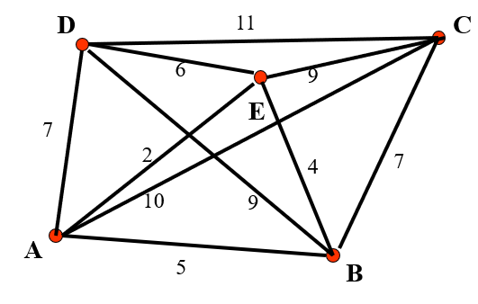
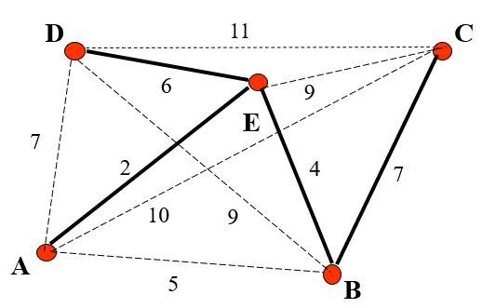
Minimum Spanning Tree Traversal Algorithm (Cont’d)
1- Find minimum spanning tree MST
Total cost of MST = 19

Slide 34
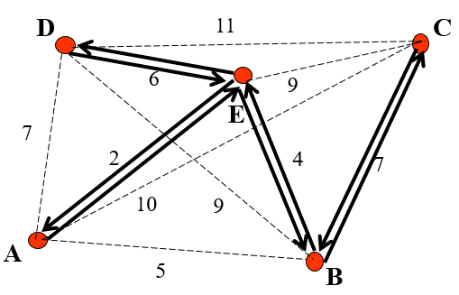
Minimum Spanning Tree Traversal Algorithm (Cont’d)
2- Traverse all the vertices of the minimum spanning tree by depth-first search, record the sequence of vertices (both visited and unvisited)
A -> E -> B -> C -> B -> E -> D -> E -> A

Slide 35
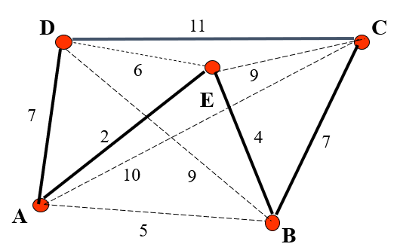
Minimum Spanning Tree Traversal Algorithm (Cont’d)
3- Use shortcut to generate the MST tour by deleting the duplicate vertices
Initial tour:
A -> E -> B -> C -> B -> E -> D -> E -> A
After Shourtcuts :
A -> E -> B -> C -> D -> A
Total cost of TS tour = 31

Slide 36
Minimum Spanning Tree Traversal Algorithm (Cont’d)
The minimum spanning tree algorithm comes with a guarantee that the tour length it comes up with will be no worse than twice as long as the optimal tour.
The cost of best possible Travelling Salesman tour is never less than the cost of MST.
The total cost of full walk is at most twice the cost of MST.
The output of this algorithm is less than the cost of full walk.
Notes:
(The definition of MST says, it is a minimum cost tree that connects all vertices).
(Every edge of MST is visited at-most twice)

Slide 37
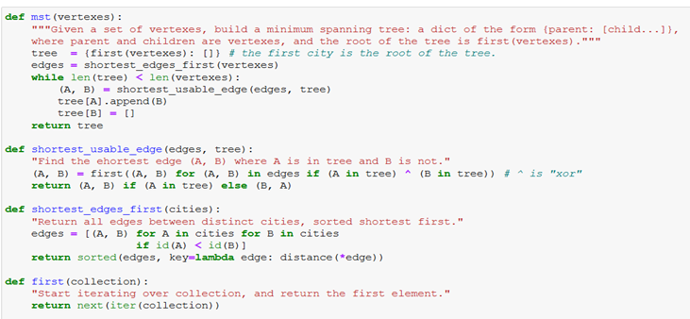
Minimum Spanning Tree Traversal Algorithm (Cont’d)
Implementation:

Slide 38
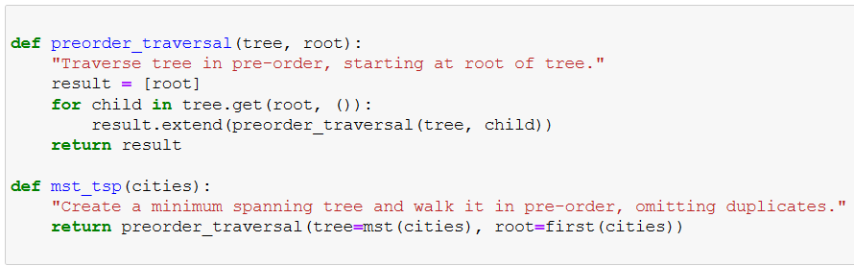
Minimum Spanning Tree Traversal Algorithm (Cont’d)
Implementation:

Slide 39
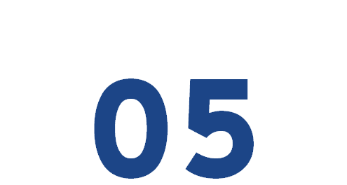
Discussion and Conclusion

Slide 40
Discussion and Conclusion
Case Study
Using (30 Cities)
Each City Represented With Point (x,y)
Undirected Graph
Euclidean TSP (Euclidean Distance)

Slide 41
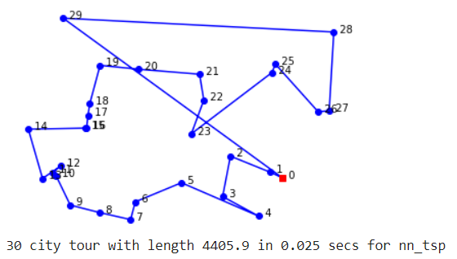
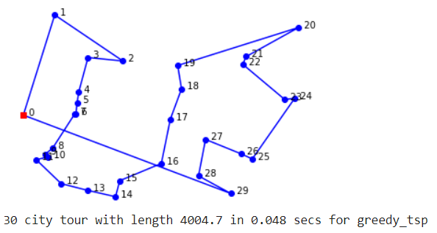
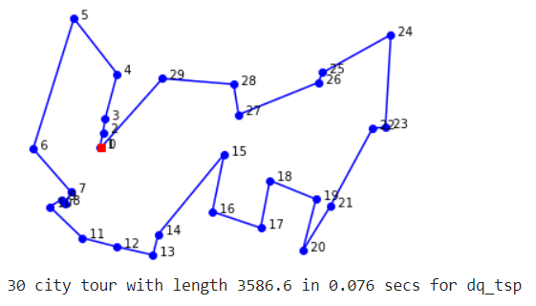
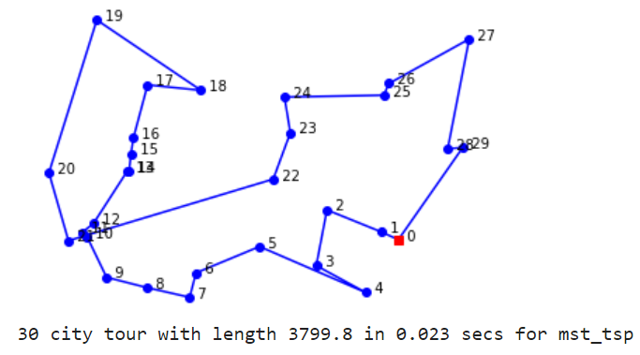
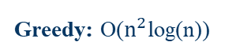

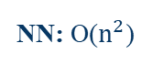

Discussion and Conclusion (Cont’d)
NN: O($n^{2}$)
Greedy: O($n^{2}$log(n))
DQ: $n^{3}$. ${\text{(}\text{Log} \text{n})}^{2}$
MST: O($n^{2}$)

Slide 42
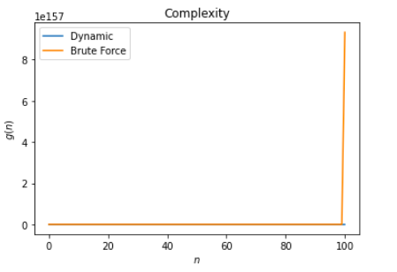
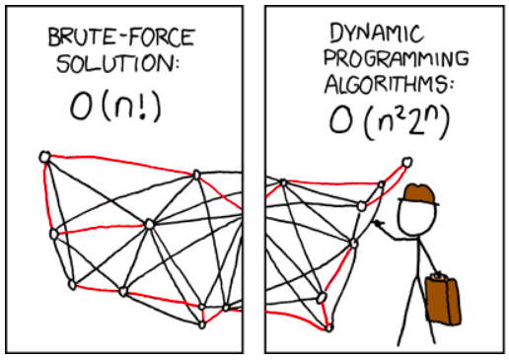
Discussion and Conclusion (Cont’d)
2. Complexities:

Slide 43
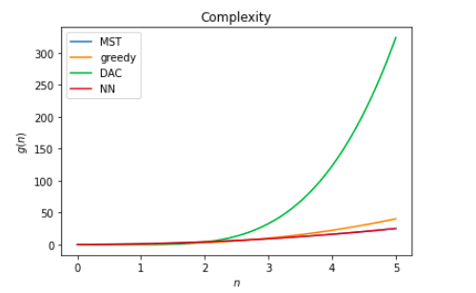

Discussion and Conclusion (Cont’d)
2. Complexities:
MST: O($n^{2}$)
Greedy: O($n^{2}$log(n))
DAC: $n^{3}$. ${\text{(}\text{Log} \text{n})}^{2}$
NN: O($n^{2}$)

Slide 44

Discussion and Conclusion (Cont’d)
2. Complexities:

Slide 45

Discussion and Conclusion (Cont’d)
3. Benchmarking

Slide 46

Discussion and Conclusion (Cont’d)
3. Benchmarking Implementation

Slide 47


Applications
Commerce
Industry
Games
Agriculture
Security

Slide 48



Further Work
Further improvements
Altering Tours by Reversing Segments

Slide 49
References
https://www.geeksforgeeks.org/travelling-salesman-problem-set-2-approximate-using-mst/
https://iq.opengenus.org/approximation-algorithm-for-travelling-salesman-problem/
https://faculty1.coloradocollege.edu/~sjanke/Slides/TSP_SJ.ppt
https://stemlounge.com/animated-algorithms-for-the-traveling-salesman-problem/

Slide 50
Thank You
Any Questions?

